Slide 1
Ensemble Reinforcement Learning for Futures Trading
A three-model approach

Slide 2
Summary
Data on 78 futures collected from Quantiacs
Calculated MACD, RSI, CCI, and ADX for trading indicators
Calculated turbulence for risk management
Fit three reinforcement learning models
Advantage Actor Critic (A2C)
Proximal Policy Optimization (PPO)
Deep Deterministic Policy Gradient (DDPG)
Metrics:
Two-Year Sharpe: 1.006
Max. Drawdown: -0.25
Win/Loss Ratio: 50.2%
Exp. Gain / Exp. Loss Ratio: 1.05:1

Slide 3
Data
Data gathered from Quantics
Contains OHLCV, Open Interest, and Rollover for 78 Futures contracts
Missing values forward filled, then dropped
Used data from 2009-01-01 through 2020-12-01
In-Sample period, for turbulence calculation: 2009-01-01 through 2015-01-01
StockStats used to calculate MACD, 30-day RSI, CCI, and ADX

Slide 4
Reinforcement Learning Algorithms
A2C:
Accepts continuous action and state spaces
On-Policy
Deterministic and easily parallelizable
PPO:
On-Policy
Easy to tune, less noisy than alternatives
The go-to RL algorithm at OpenAI
DDPG:
Combines advantages of Actor-Critic and Deep Q-Learning
Off-Policy to learn Q-Function, then uses Q-Function to learn policy
Easy to parallelize

Slide 5
Environments
Separate environments for Training, Validation, and Trading
Observation Space:
Continuous in [0,∞)
Each state has 469 values
Action Space:
Continuous in [-1, 1]
Re-Scaled to [-100, 100] contracts
Reward Space:
Unscaled → Difference in total equity
Scaled → Percent difference in total equity

Slide 6
Observation Space
 | Unscaled | Scale Method | Scaled
Cash Holdings |  | None
Close Prices | (0, 34,081) | 1/(Initial Value) | (0, 10)
Number of Contracts Held |  | None
MACD | (-2543, 1017) | Standardize | (-34, 11)
RSI | [0, 100] | 1/100 | [0,1]
CCI | (-1000, 1000) | Standardize | (-9, 9)
ADX | [0, 100] | 1/100 | [0,1]

Slide 7
Action Space
Vector of actions, with one action per Future
Number indicates how many of each Future to buy/sell
Positive Action → Buy
Negative Action → Sell
No short selling
No Leverage
Scaled between -1 and +1, then multiplied by 100

Slide 8
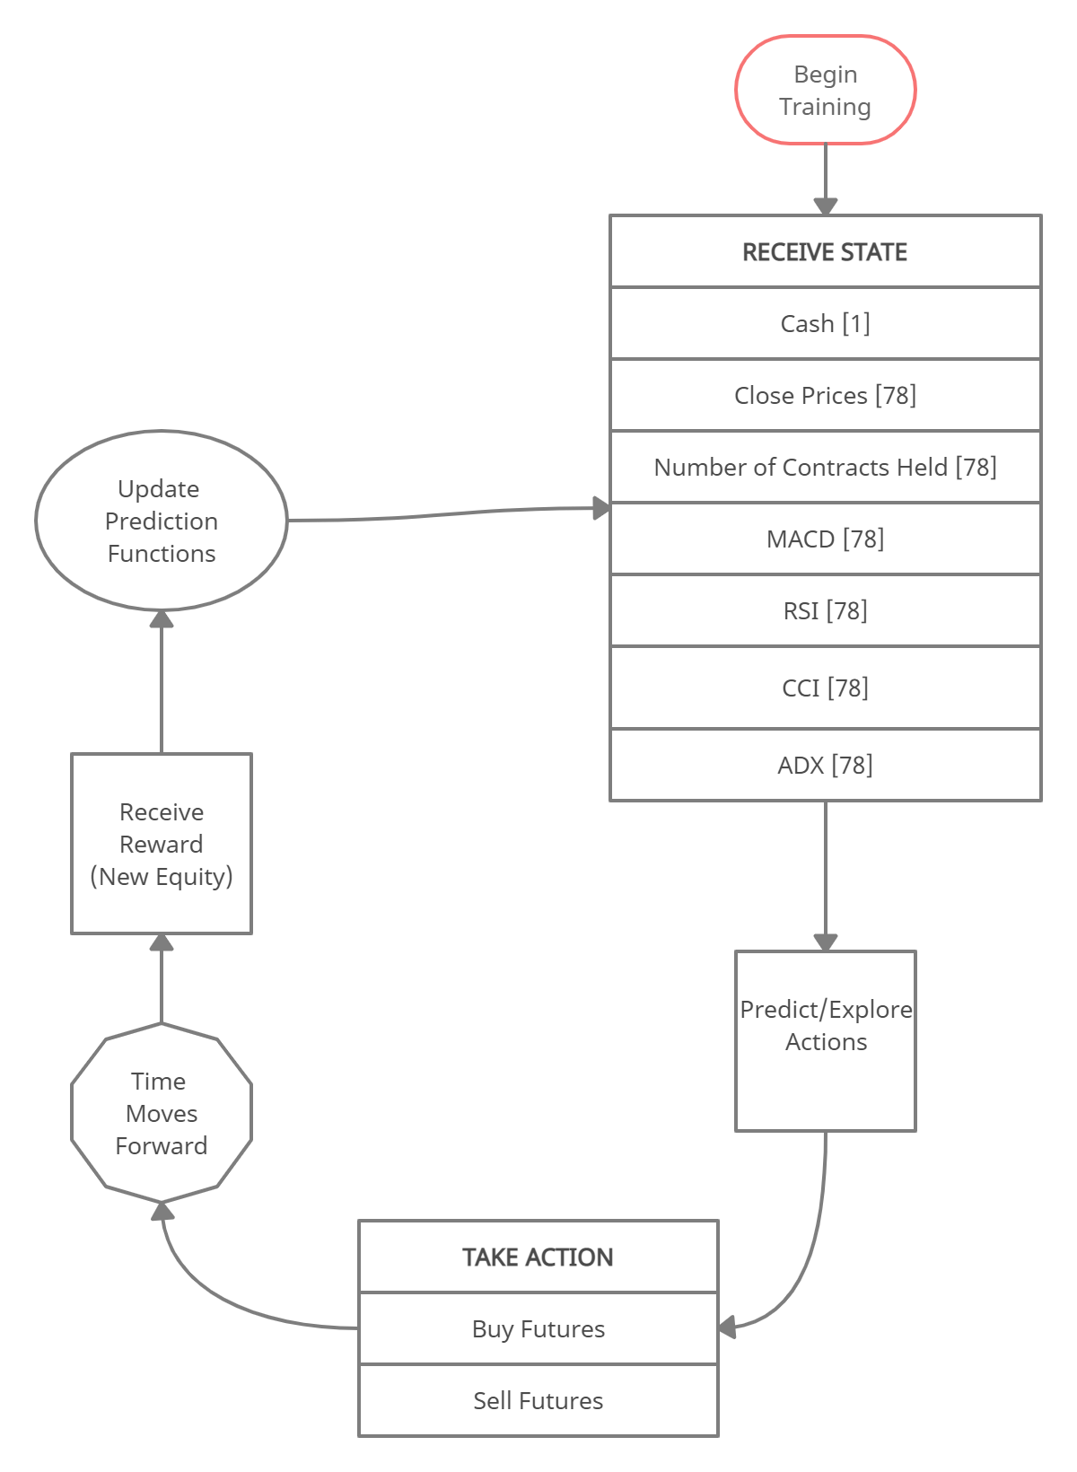
Training Loop

Slide 9
Trading System
Train each RL algorithm on data from 2009-01-01 to day (t - 63)
Validate each RL model by trading for 63 days
Evaluate the Sharpe Ratio from each model in the validation period
Selected the Best Model with the highest Sharpe
Use the Best Model to trade for the next 63 days
Repeat

Slide 10
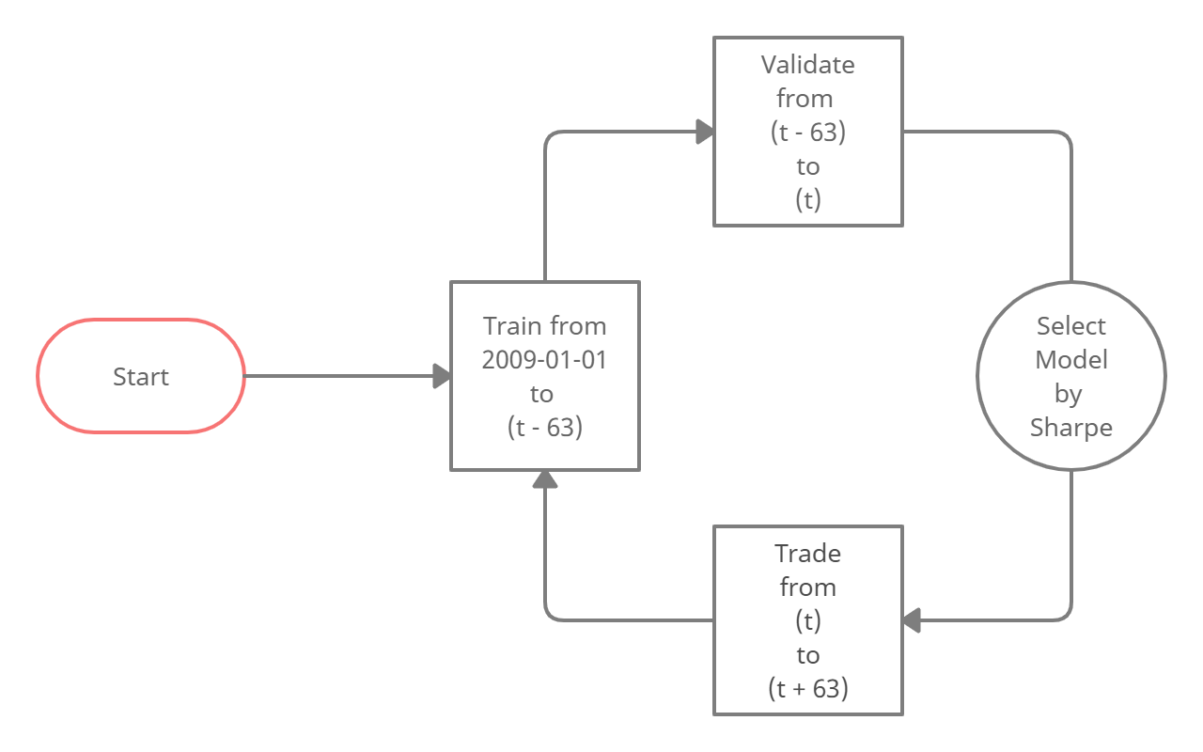
Trading System Loop

Slide 11
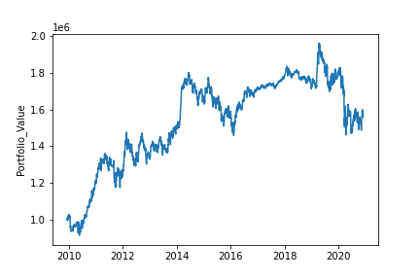
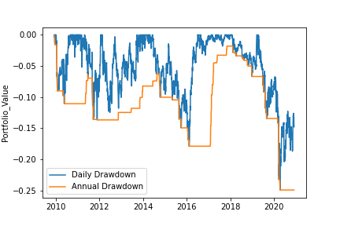
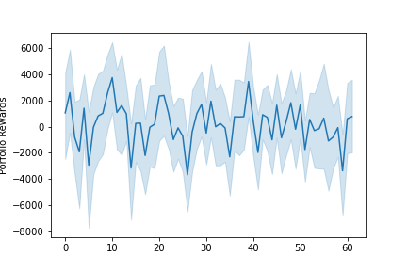
Unscaled Version Results
Total Sharpe: 0.41
Two-Year Sharpe: -0.26
Annualized Return: 4%
Max Drawdown: -25%
Pct. Winners: 50.2%
Mean-Win/Mean-Loss: 1.05:1

Slide 12
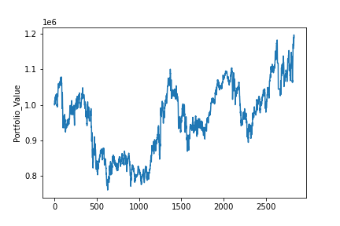
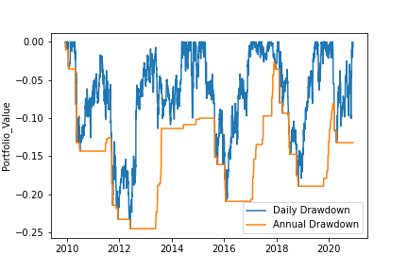
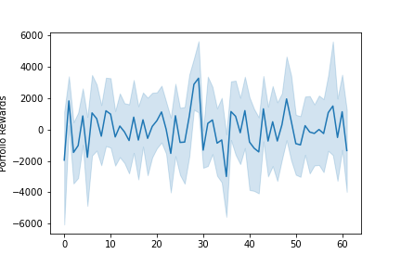
Scaled Version Results
Total Sharpe: 0.18
Two-Year Sharpe: 1.006
Annualized Return: 1.5%
Max Drawdown: -25%
Pct. Winners: 49%
Mean-Win/Mean-Loss: 1.05:1

Slide 13
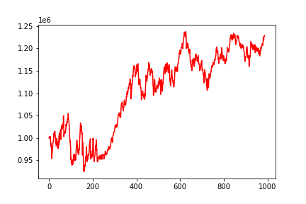
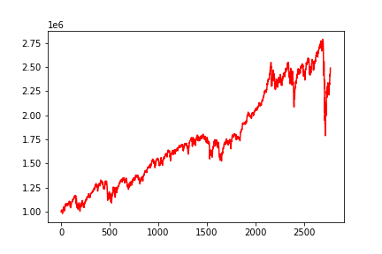
Training Fit Comparison
Unscaled Version
Scaled Version

Slide 14
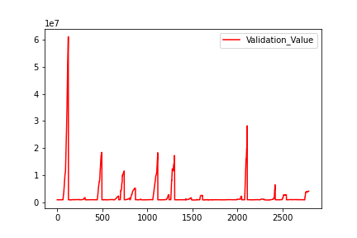
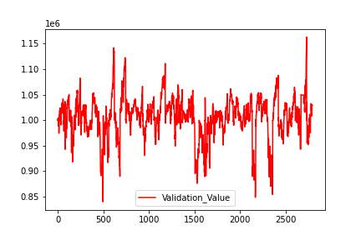
Validation Fit Comparison
Unscaled Version
Scaled Version

Slide 15
Thoughts
The scaled version is fitting nicely to the training data, while the unscaled version performs better on validation data
This indicates a sort of overfitting in the scaled version, where the RL algorithms are finding patterns that are not persistent or reliable
Neither version is consistently profitable in the trading environment, but…
Performance in the validation periods gives us reason to believe that the unscaled version could be tweaked into consistent profitability
Overfitting on the training data is evidence that the scaled version is finding patterns that may be generalizable to validation and trading periods
More research is necessary

Slide 16
Next Steps
There is strong evidence that the scaled version can be profitable if the fit problems are addressed.
Ideas to improve performance
Adjust number of training timesteps for each model
Retrain Best Model on the validation window before using it for trading
Adjust scaling (make MACD and CCI ranges closer to [-1, 1])
Train the models on many more periods of synthetic data

